Slide 1

Motivational Reflexivity
An Enjoyable Practice
Aligning Beliefs with Reality and Values for Personal Growth and Well-Being

Slide 2

What is Motivational Reflexivity?
A self-reflection process aimed at aligning beliefs with reality and ethical values.
It enhances personal well-being and helps overcome internal obstacles to goals.
It can be framed in terms of an enjoyable hobby and integrated with relaxation activities for an engaging experience.

Slide 3




Getting Ready
Choose a quiet, comfortable environment.
Have a notebook or digital tool to record your reflections.
Select a practical goal and an enjoyable pastime as a theme to guide your practice.

Slide 4
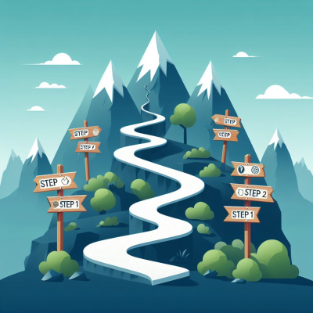
Step 1: Set Your Scene
Focus on a specific life goal (e.g., career success, academic recognition, family happiness).
Frame your practice around a relaxing activity or hobby (e.g., Gardening, sports, art, cooking.

Slide 5
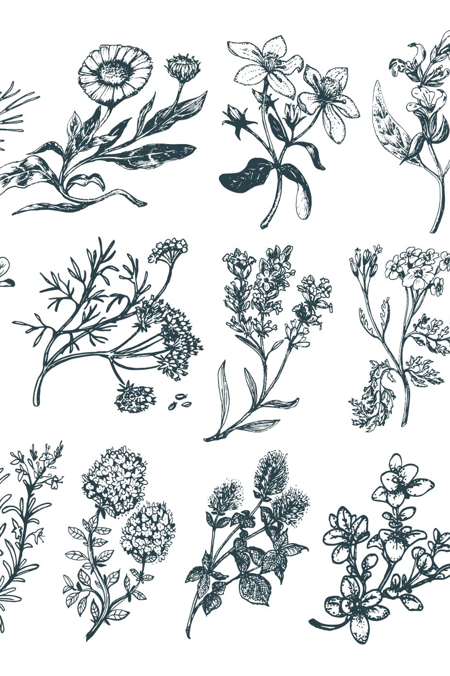
Step 2: Identify a Belief
Reflect on a belief influencing your ability to achieve your goal.
Use your theme to visualize it:
  Gardening: A beautiful shrub or bindweed?
  Sports: A winning or losing strategy?
  Art: A master stroke or a disaster?
Write it down and consider its impact.

Slide 6



Step 3: Understand the Origins
Explore the source of the belief:
  Is it self-formed or influenced by others?
Visualize this within your theme:
  Gardening: What’s the root?
  Sports: Who coached this idea?
  Cooking: Where did this recipe come from?

Slide 7

Step 4: Evaluate Its Impact
Assess the belief’s effect on your life or goal:
Positive: Helps well-being or progress.
Neutral: Little effect.
Negative: Hinders well-being or progress.
Use your theme to visualize the evaluation.

Slide 8
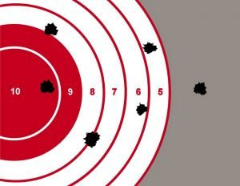
Step 5: Challenge and Refine
If the belief is unhelpful:
  Replace or refine it.
Visualize this within your theme:
  Gardening: Prune and replant.
  Sports: Revise the strategy.
  Cooking: Adjust the recipe.

Slide 9
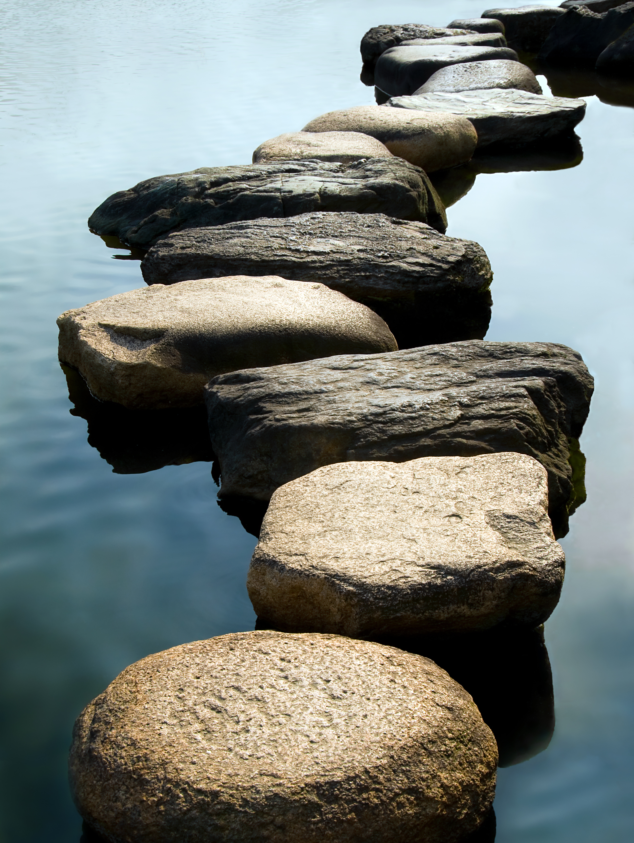
Step 6: Integrate New Insights
Adopt a revised belief that aligns better with reality, your values, and your goal.
Identify actionable steps to reinforce the new belief in daily life, e.g., approaching challenges with confidence.

Slide 10

Step 7: Reflect and Celebrate
Reflect on what you’ve learned and accomplished.
Celebrate small wins:
Example: "I’ve replaced one limiting belief!"
Plan regular revisits to refine your practice.

Slide 11
Additional Tips for Practitioners
Use journaling prompts to explore beliefs.
Pair reflection with mindfulness exercises.
Incorporate music or ambiance to enhance relaxation.
Celebrate each milestone to stay motivated.

Slide 12

Closing Notes
Motivational Reflexivity is a journey, not a one-time task.
By using it to achieve goals and integrating hobbies, you make the process enjoyable and enriching.
Remember to be patient and kind to yourself.

